Slide 1
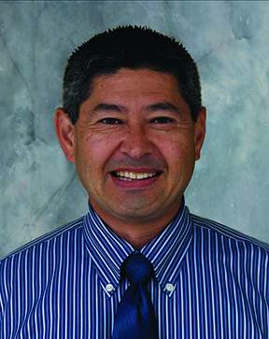
Building a Better Mousetrap: How Fleet Services Is Applying Lessons Learned at Process Palooza
Greg Nishihira, Assistant Director, Fleet Services

Slide 2
A UC San Diego Process Used to Help UC
Meet Carbon Neutrality Initiative Goals

Slide 3
Why do we have this process?

Slide 4
Why do we have this process? (READ: Why are you putting us through the wringer when trying to get a new vehicle?)

Slide 5
Why do we have this process?
UC has a goal to be carbon neutral by 2025. This is referred to as UC’s Carbon Neutrality Initiative (CNI)
The Vehicle Request process is used as a method to help Fleet Services do its part to reduce UC San Diego’s vehicle carbon emission footprint
Although the UC Fleets represent a very small percentage of UC’s overall carbon emissions, they are one of the most visible

Slide 6
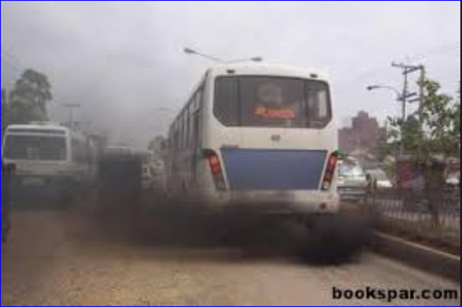
(Not what we want to be associated with!)

Slide 7
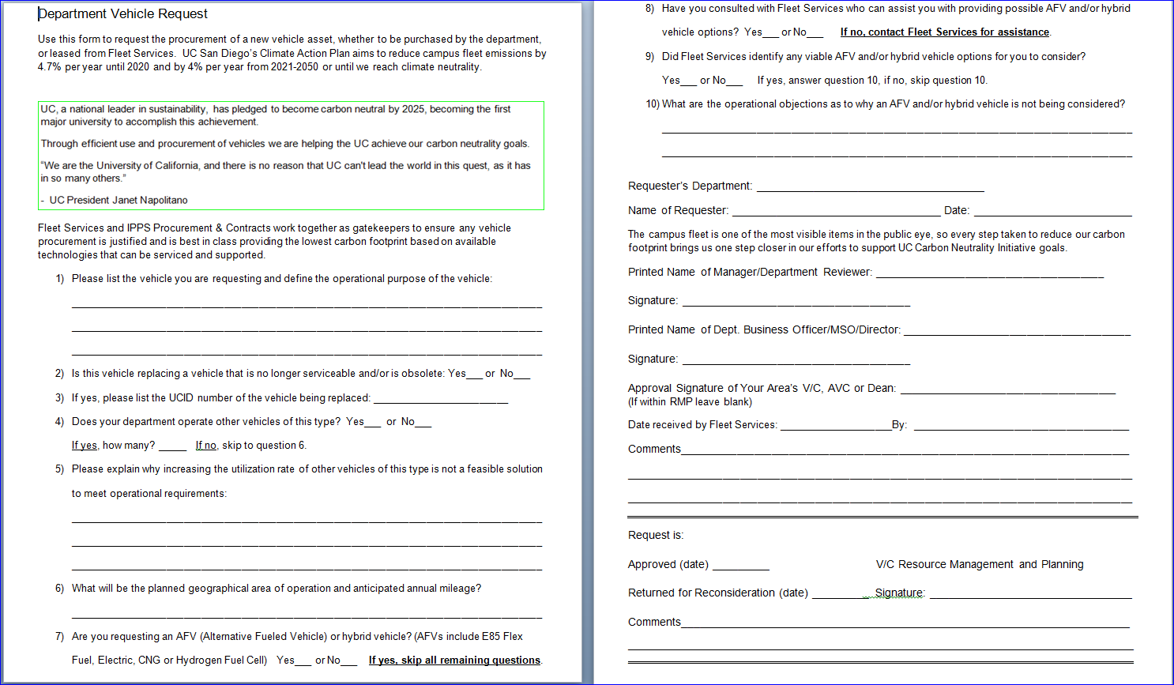
How?
The primary tool used to help us enforce the process is the Department Vehicle Request form
Implemented as an RMP supported process over 10 years ago
Establishes a dialog
Requirements and guidance have changed over the years

Slide 8
Challenges
Enforcement of the policy, however, has been cumbersome and required extensive resources to be marginally effective. It was not fail safe and it created confusion, animosity and excessive delays

Slide 9
Process Dialog
Hi Fleet. This is Procurement. We have a vehicle being requested
Thanks! From who?
King Triton
Can you wait while I research that?
Ok. But please hurry. We don’t like requests in cue for too long
Got it…
Hmmm. We don’t see anything from King Triton

Slide 10
Sorry, King Triton, but Fleet doesn’t have a Vehicle Request form from you
Hey Fleet. King Triton says a request was completed
Oh yes! Sorry, we located it. We’ll let you know if and when it’s approved
Sorry King Triton. They found it. Please hold tight for an approval

Slide 11
Challenges
Multiple pain points where vehicle request forms were unaccounted for along with back and forth communication
Since IPPS Procurement sets eyes on all vehicles being procured, they were the primary hub of communications
Although it’s a Fleet Services process, Procurement was often the front line of enforcement. Not ideal!

Slide 12
Enter Process Palooza!
In September 2018 Fleet Services was presented with an opportunity to have our Vehicle Request process analyzed (Read: There are a lot of unhappy people who are confused with your process and you are in dire need of help!)
3 Lean teams analyzed the process
Key takeaways presented
All teams provided useful ideas and suggestions, with many implemented

Slide 13
Key Takeaways
The approval process takes a long time
People do not understand why this needs to be done
People do not understand how it should be done
Vehicle guidance lacking
Not easy to find available information
The department has opportunities to grow by listening to input and suggestions from colleagues

Slide 14
Key Suggestions Implemented
All vehicles procured by the campus route to Fleet Services as a first approval step. Since we are now the gatekeeper to ensure policy compliance, no interaction with IPPS Procurement is required if the vehicle has been approved. This was a pivotal suggestion in that it has effectively eliminated many of the challenges formerly encountered
Better educate our campus community on the process. We have spelled out the process through a link on our Blink homepage, along with simplifying our URL to fleet.ucsd.edu

Slide 15
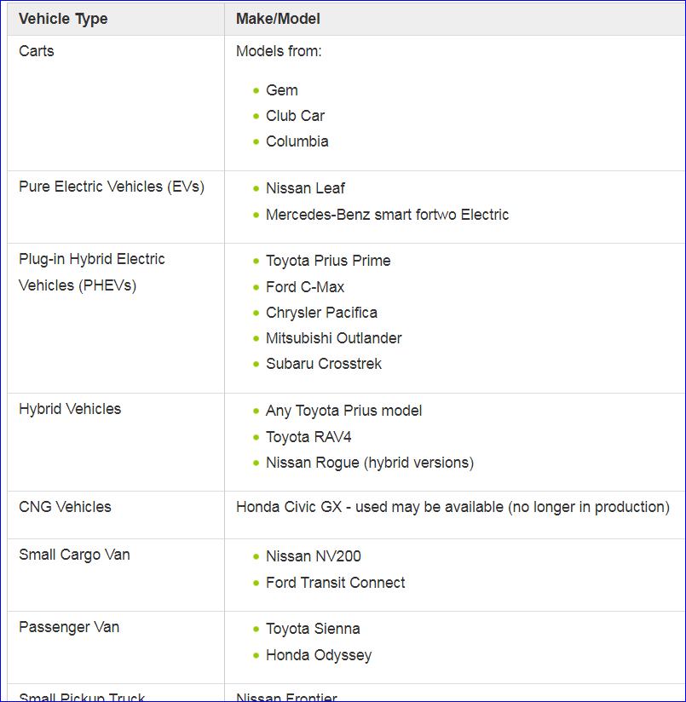
Key Suggestions Implemented
Better educate people as to which vehicles are considered compliant. We now have a list of “best in class” vehicles on Blink
The need to help UC meet CNI goals is a narrative conveyed so that people understand why this policy and process is in place

Slide 16
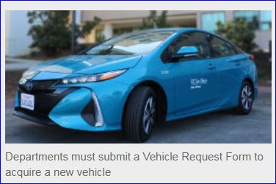
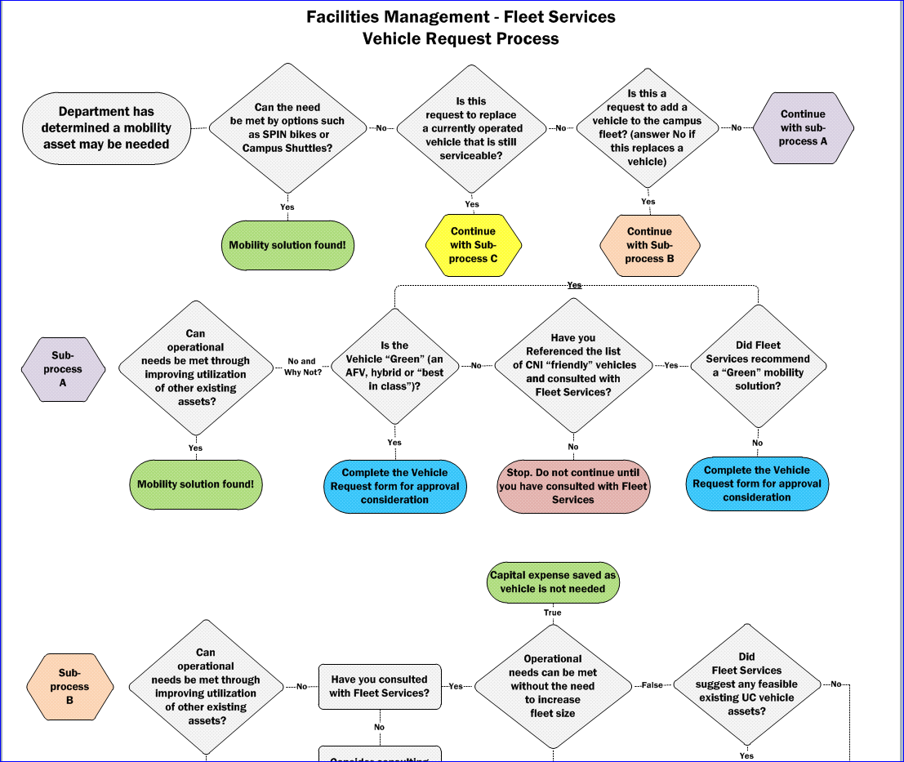
Key Suggestions Implemented
A flowchart that defines the process has been developed, and is available as a resource to those who find a visual explanation beneficial
Improve awareness through outreach and publicity
Blink teaser – September 2019

Slide 17
Other Suggestions
“Make it competitive” This would be done by publishing the % of “green” vehicles by V/C area or department. The Office of Sustainability has been approached on this, but has not engaged with us yet
“Draft and post a survey” We see this as being a potentially valuable tool, but have yet to define the questions. Most colleagues who procure vehicles are now aware of the process, but we can still learn by implementing this tool
“Migrate the form to an electronic version” We feel there’s a “weeding out” benefit in making the form less accessible. Our goal is to ensure a bona-fide need exists for a new vehicle. A more traditional process helps to separate those who simply want a vehicle as opposed to those who have a critical operational need for one

Slide 18
Results
The approval time for most approved Vehicle Requests is now 3 business days or less. Vehicles not approved may take up to 21 days. Before this year, most vehicle requests were taking 10-21 days for a decision to be made
The average number of new vehicles procured by UC San Diego in each of the last 4 years (CYs 2015, 2016, 2017 and 2018) was 106.75. As of October 1 we are at 37 vehicles this CY
We are on pace to procure 49 vehicles this year, based on the total number procured through the first 3 quarters – a reduction of over 50%
This equates to a capital cost savings for the University of…

Slide 19
$1,743,016
If we account for a slight increase in maintenance costs of older vehicles, the net cost reduction is approximately $1.7 million
Cost avoidance is based on the average cost of vehicles procured so far this year of $30,052

Slide 20
Summary
We were provided an opportunity to have our processes looked at from a fresh, external point of view
The suggestions implemented have reduced turnaround time and have greatly improved communication of the process (why, how and resources)
There is much better control in place to support the process
Responsibilities properly aligned and efficiencies gained
Contributes to the overall effectiveness of helping us to achieve cost control

Slide 21
It takes a Village…
IPPS Procurement
Resource Management and Planning
Campus Asset Management
Policy and Records Administration
EH&S Risk Management
RMP Marketing and Communications
Most importantly, it takes YOU!

Slide 22
Thank You!
Photo courtesy of RMP Marketing and Communications

