Slide 1
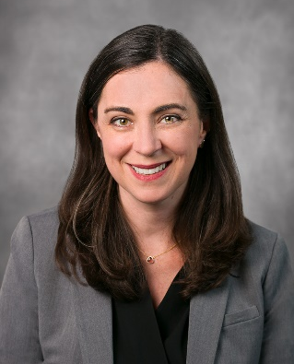


Shifting Culture with Everyday Improvement at UC San Diego Health
Ashley Gambhir, Senior Director, Transformational Healthcare and Ambulatory Innovation, UC San Diego Health

Slide 2
Transformational Healthcare
UC San Diego Continuous Improvement Summit

Slide 3
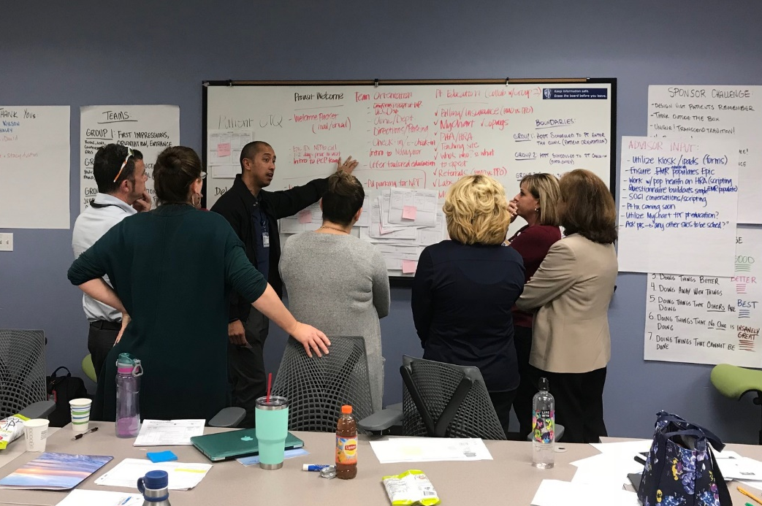
Why Lean at UC San Diego Health?

Slide 4

Clarity of Purpose
2018 Priorities
Improve Operational Performance
Grow our scale and scope
Team Development
GROWTH
EXPERIENCE
To achieve these priorities, we need to:
CLINICAL
EXCELLENCE
PERFORMANCE
MANAGEMENT
1. Deliver the Highest Quality of Care
Additional benefits:
Reduced Costs/Increased Revenues
Improved Quality
Improved Morale
Increased ability to adapt in changing healthcare environment
2. Reduce the Burden of Doing our Work
Notes:
reduce the cost of production through the removal of waste and increase value for our patients.

Slide 5
Why should we care about lean?
Lean supports our organizational objectives
High Reliability
The Big E
Operational Excellence
Engagement and Alignment
Innovation
Enables us to do quality work efficiently
Focuses on fixing processes, not people
Increases individual and collective capacity within the organization
Empowers everyone to solve problems at the appropriate level
Prevents burnout and increases retention
Increases patient and employee satisfaction
Efficient, waste-free processes help UC San Diego Health remain competitive in a competitive industry

Slide 6
What is Transformational Healthcare?
What it is
Leadership Led
What it isn’t
Consultant Led
Enterprise-wide management system
Framework/Set of Tools
Ongoing support with Coaching
Inconsistent/Silo’d Approaches
Centralized/Prescribed
“One and Done” Training
Another “topic of the day”
Ingrained into our culture
Notes:
Managers should own this in how they do their job every day

Slide 7

Visioning
To create a healthier world — one life at a time — through new science, new medicine and new cures.
10,000+ Problem-solvers relentlessly improving the value of care for our patients while loving their jobs

Slide 8
How many reasons do we need?
93,700
PATIENT LIVES
83,000
PHYSICIANS
1,600
STAFF
9,100
We can engage through everyday improvement

Slide 9
Employee Engagement Top 3’s
Conditions for
Engagement
Engagement
Opinions
Employee
Behaviors
Relationships with co-workers
Opportunities to use skills and abilities
Meaningfulness of their job
I am confident I can meet my work goals
I am determined to accomplish my work goals
I have a clear understanding of my organization’s vision/mission
The people in my work group never give up despite difficulties
My colleagues quickly adapt to challenging or crisis situations
In my organization, employees are encouraged to take action when they see a problem or opportunity
Source: Employee Job Satisfaction and Engagement (SHRM, 2016)

Slide 10
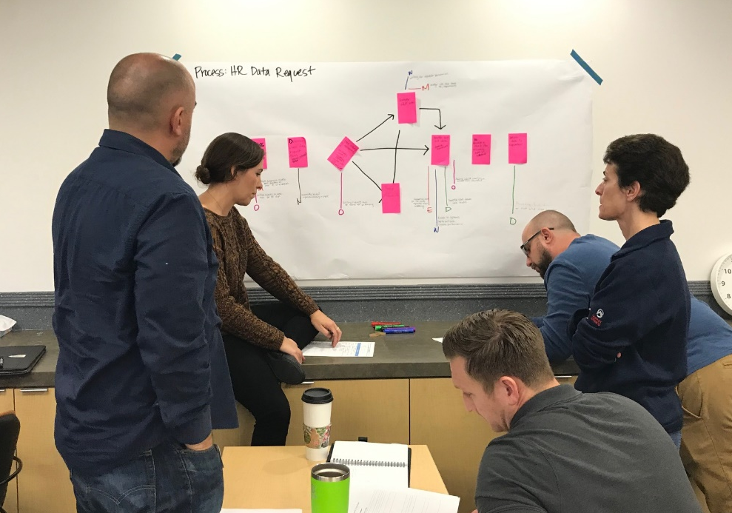
Your Teams’ Involvement Matters!
Problem solving is a shared responsibility
You know your work best
It improves value for patients
It allows you to own the improvement and decision making
Improves teamwork
Notes:
Problem solving is a responsibility for all employees. View improvements in a systematic way. Understand the priorities of the organization and align your efforts to support these priorities.

Slide 11
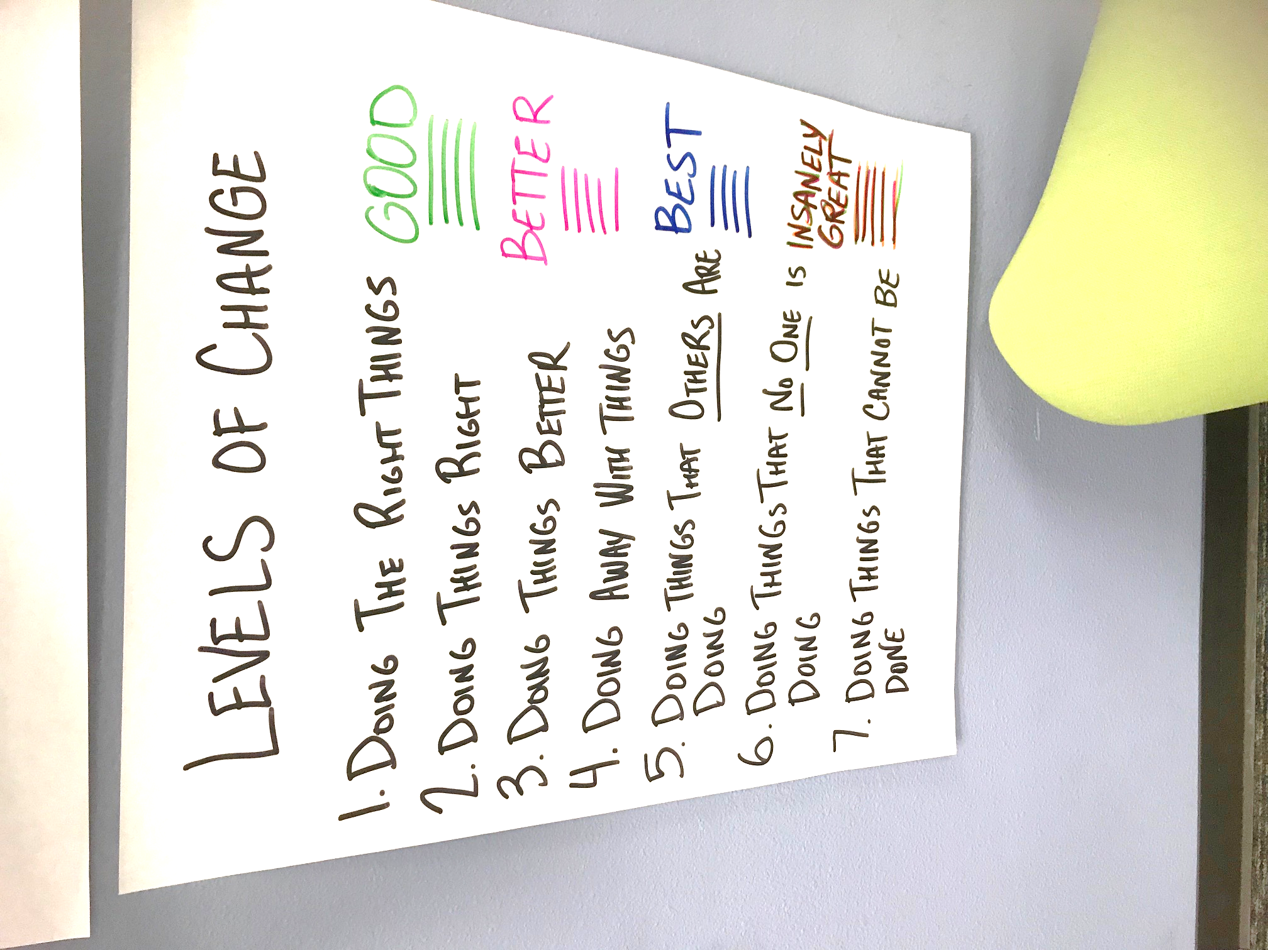
Our Approach

Slide 12
Transformational Healthcare Team Mission
Our Mission is to cultivate
a culture of continuous improvement
at UC San Diego Health to
deliver outstanding patient care.

Slide 13
Key Considerations
  What problem are we trying to solve?
Value-Driven Framework
  How do we develop people who can change the work correctly?
Capability
Foundational Elements
Leadership
  What leadership behaviors and management systems are needed?
Process and Tools
  How will we equip people to enable us to achieve the improvements?
Culture
  What basic thinking, mindsets, and assumptions need to shift?

Slide 14
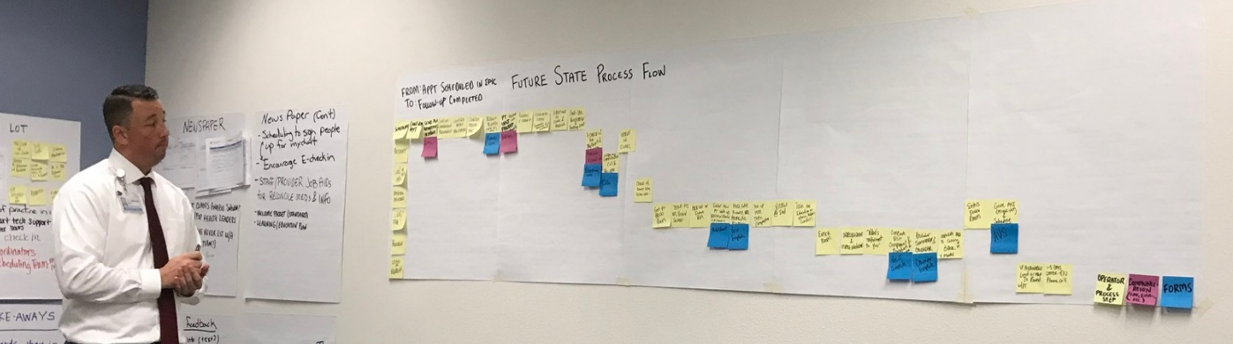
Timeline
2018
2019
J
F
M
A
M
J
A
S
O
N
D
J
M
A
M
J
J
A
S
O
J
F
Proof of Concept
Pilot in Ambulatory
Launch
Improvement Workshops
Foundations Training
Basics Training
Intermediate Training
Daily Engagement System in Outpatient Setting
Coaching for Problem Solving
Support Strategy
Daily Engagement System in Inpatient Settings
Advanced Training
Leader Standard Work

Slide 15
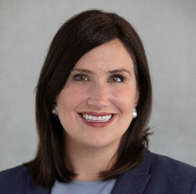
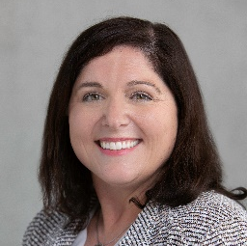
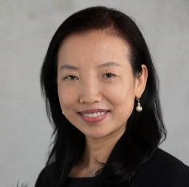
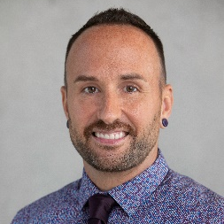
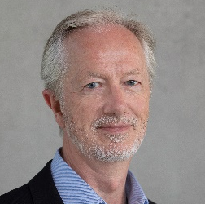
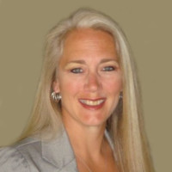
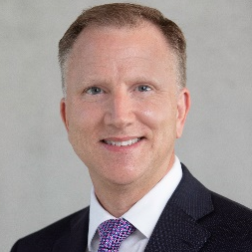

Building the Backbone Team
Guiding Principles
Our patients define value.
We show respect for all people in every interaction.
We trust each other and have demonstrate high integrity as a supportive team
We share our knowledge and are transparent in our intents.
Our continuous improvement mindset encourages creativity and innovation.
We provide opportunities to learn and build lean-thinking capability
Our work aligns to organizational priorities and we measure our impact
We proliferate best practices and design for sustained value

Slide 16
How do we create an organization of problem solvers?
Leadership
Strategic Alignment
Daily Engagement System
Build Capability
Improvement Events
Active, visible sponsorship is critical to cultural transformation
High-impact workshops plus small daily PDSA improvements
Tools, frameworks, concepts
Foundations
Basics
Intermediate
Advanced
Process for setting and cascading goals – and committing to them
Organizational rollout

Slide 17

Evolving our Operating System - How we do our work
ALIGNMENT
3P
Strategy Alignment
Value Stream Thinking
SUCCESS
IMPROVEMENT
RPIW
Kaizen
Black Belt Projects
SUSTAINMENT
Daily Engagement System
Rounding
PDCA
Standard Work
Focus on the customer (patient)
  Understand Needs
  Show Respect
Improve the tasks which create a process
  Focus on Value
  Eliminate Waste
  Engage all hearts & minds

Slide 18

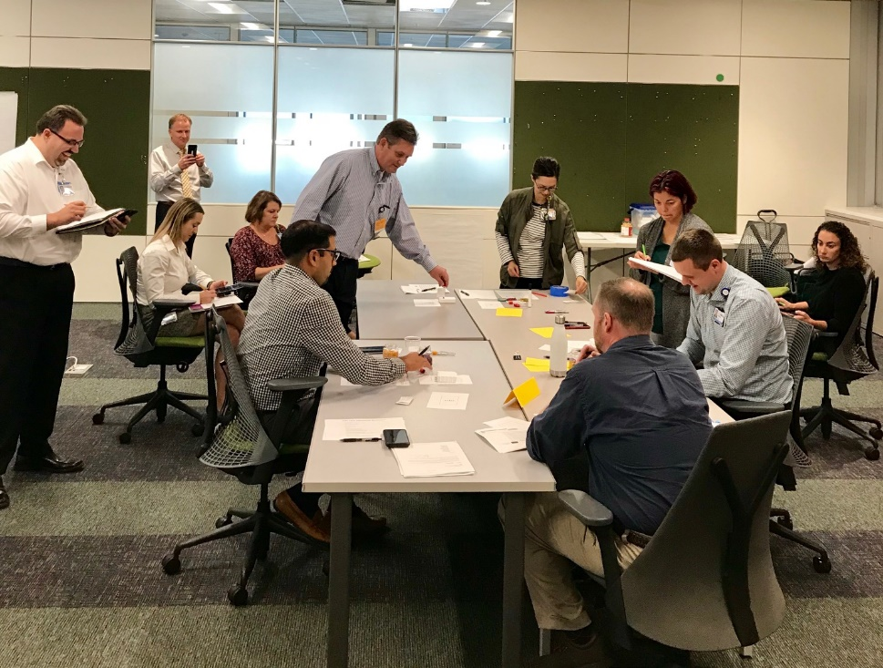
Early Successes

Slide 19
Year 1 Accomplishments
Rolled out basic and intermediate training
Launched institutional Report Outs
Created pathways for collecting Voice of Customer
Piloted the Daily Engagement System
Launched Rapid Process Improvement Workshops
Created content on Pulse intranet
Defined metrics for balanced scorecard
Developed standard work
Defined a Lean Coaching Strategy
Hired the Transformational Healthcare Team

Slide 20
Completed Transformational Healthcare Workshops
RPIW#002
3P#002
RPIW#004
RPIW#005
RPIW#006
3P#001
RPIW#001
RPIW#003
RPIW#007
Primary Care Design (August 2017)
Reducing the Physician Burden of Work (December 2017)
Welcome to UC San Diego Health Experience (February 2018)
Access Center (March 2018)
Optimizing the General GI Patient Experience (March 2018)
Simple Scheduling for Primary Care (June 2018)
Neurology Referral Authorizations (June 2018)
Daily Engagement System for CPO (July 2018)
CommUnity Care Physician Onboarding Process (November 2018)
RPIW#008
Shiley Patient Wait Times (November 2018)
RPIW#009
Kidney Transplant Throughput (December)
DES#001
Ambulatory (Fall 2018)
DES#002
PeriOp and W&I (Winter 2019)
Training Pilot
Foundations, Basics, Intermediate (Fall 2019)
RPIW#010
Referral Reply Turnaround Rate (May 2019)
RPIW#011
Infusion Lab Throughput (June 2019)
RPIW#012
Lead Time for Imaging for Cardiovascular Patients (August 2019)
RPIW#012.5
Imaging Backlog for Pacemaker Patients

Slide 21
Quantitative Results from Pilot
$1.7 million in UCSDH hard savings + impacts to quality, service, and efficiency
GI reduction of no show rate leads to $300K
Neurology referral authorization improvement leads to $360K savings
Labor and Delivery supply cart in HC and JMC results in $419K savings
Kidney transplant patient wait time reduced from 400 days to 106 days
Patient Satisfaction score in VLJ urgent care improved from 21% to 80%; Nurse 43% to 94%; Doctors 31% to 85%.
Increased on time start for 1st case C-sections scheduled in the L&D room at JMC from 1% to 75%
Improved the percent of Geriatric ED patients screened for Palliative care from 5% to 80%
Improved medication scan rate for Hillcrest L&D from 27.7% to 95%
Reduced new patient scheduling time from 20 days to <7 days at Department of Neurosciences
Reduced surgery clearance process to <48 hrs at Orthopedics Department
Reduced time to room a patient from 15 to 10 minutes at RB PC clinic
Decreased inappropriate calls to "we listen" line by 50%

Slide 22
By July 2019, more than 1,200 employees participated directly in lean thinking
VISION: 10,000+ Problem-solvers relentlessly improving the value of care for our patients while loving their jobs
# People Huddling via Daily Engagement System | 602
# Attended Lean Training | 459
# Rapid Process Improvement Workshop Participants | 158
Total | 1,219

Slide 23
Voice of Customer – Our Staff and Caregivers like it!
Excellent quality
Over 80% of Trainees scored “Strongly Agree” to the statement I would recommend this class to someone else.
Great Feedback
“I feel better prepared to find waste and trouble shoot problems.”
“Amazing instructors with amazing capabilities and personalities. Really motivational and encouraging throughout.”
“This training should be mandatory for everyone in the org.”
51 A3 Projects

Slide 24
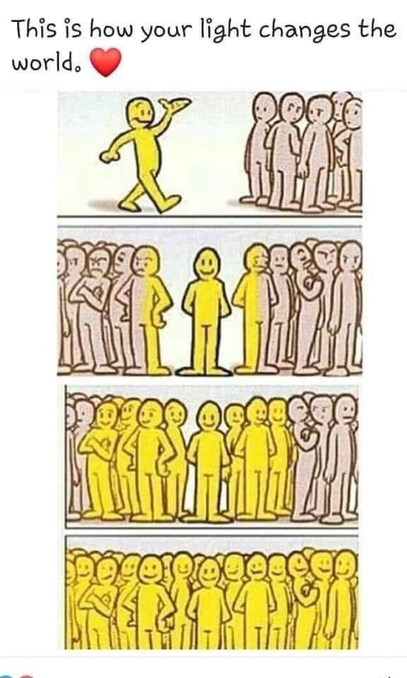
What Happens when you Create a Culture of Continuous Improvement in Health Care?
Benefits
Empowered Teams
Reduce or eliminate waste
Control variation
Proactive (not reactive) Management
Examples
Engaged team members
Less inventory
Decreased risk of medication errors
Reduced patient wait times
Focus on Value-Add to Patient/Customer
Faster processing of medications

Slide 25
Thank you!
Ashley Gambhir
Senior Director, Transformational Healthcare and Ambulatory Innovation
UC San Diego Health
858-249-3472
agambhir@ucsd.edu
pulse.ucsd.edu/transformational-healthcare (login required)

