Slide 1
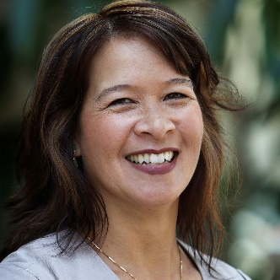


The Role of Leaders
In Building a Continuous Improvement Culture
Tracy O'Rourke, Managing Partner, GoLeanSixSigma.com;
Lean Six Sigma Green Belt Instructor, UC San Diego Extension

Slide 2
The Role of Leaders
In Building A Continuous Improvement Culture

Slide 3



About Our Presenter
Managing Partner at GoLeanSixSigma.com
Co-Author of
The Problem-Solver’s Toolkit
Co-host of the
Just-In-Time Café Podcast
UCSD Lean Six Sigma Green Belt Instructor
Tracy O’Rourke
/Tracy-ORourke
@RourkeTracy

Slide 4
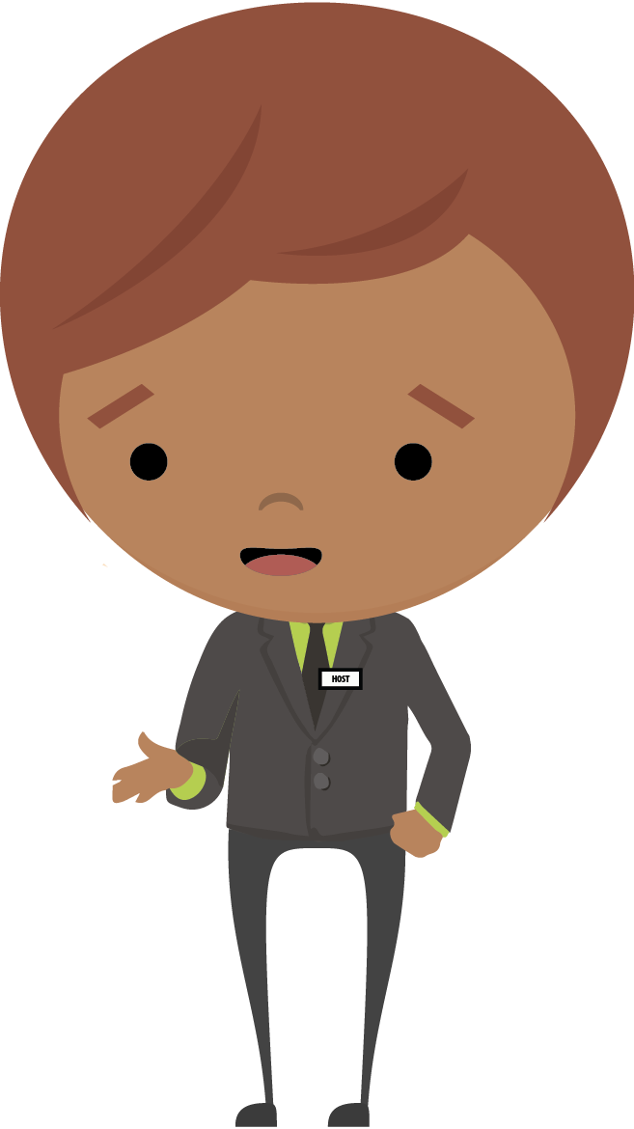
Today’s Agenda
Why tools are not enough
An overview of the 4 components
Leadership’s role in building culture
Building a roadmap for Lean transformation
Actions to address each component
Notes:
What front-line problem-solvers need to do is typically clear – learn the methods, tools, and approaches and start applying them
But for leaders it’s been a bit gray on what they need to do specifically. So, my hope is to at least share a framework for leaders to start organizing their thoughts and actions around what they can do to become a true catalyst for change and process improvement.
Today’s agenda is:

Slide 5
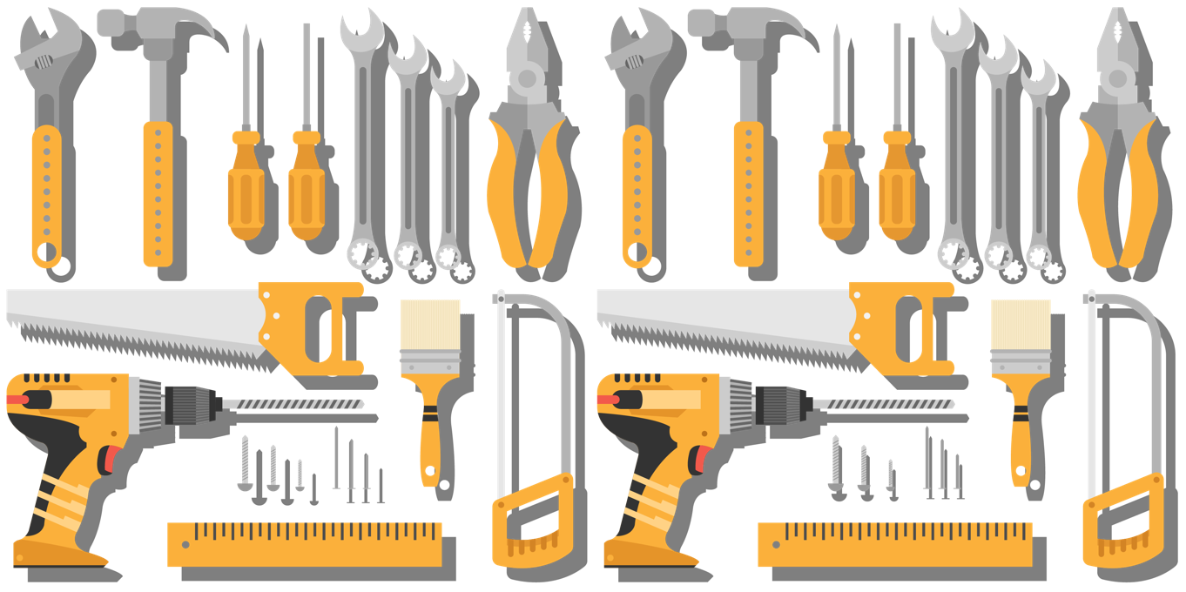
Tools Are Not Enough
Notes:
Many organizations begin to pursue continuous improvement, but are unable to get the results they desire over the long term.
A common reason for this underperformance is pursuing continuous improvement as a set of tools in isolation from the business
Continuous improvement requires a deeper change in the organization – that can penetrate an organization’s culture

Slide 6



Changing Mindset
Lean Tools Applied
Lean tools applied
Existing
Management Mindset and Practices
Existing management mindset and practices
Many organizations add Lean tools on top of
existing management routines and thinking
Projects and Workshops ≠ Continuous Improvement
Notes:
There are a lot of reasons why Lean fails in organizations,
Often failure occurs because organizations simply add the tools of Lean onto current mindset and management practices.
If there is a high blame organization how will process improvement flourish, if people are afraid to admit that there is a problem?
Womack said, change the mindset of management, have better managers with a better mindset. But how?
This is how to freeze leadership. It’s not clear what they should be doing as a leader to support a Lean environment and a Lean culture.
What are the challenges with changing a mindset?
How do you change a mindset?
If you knew what to do, you’d do it, right?
Transition...One approach is...

Slide 7
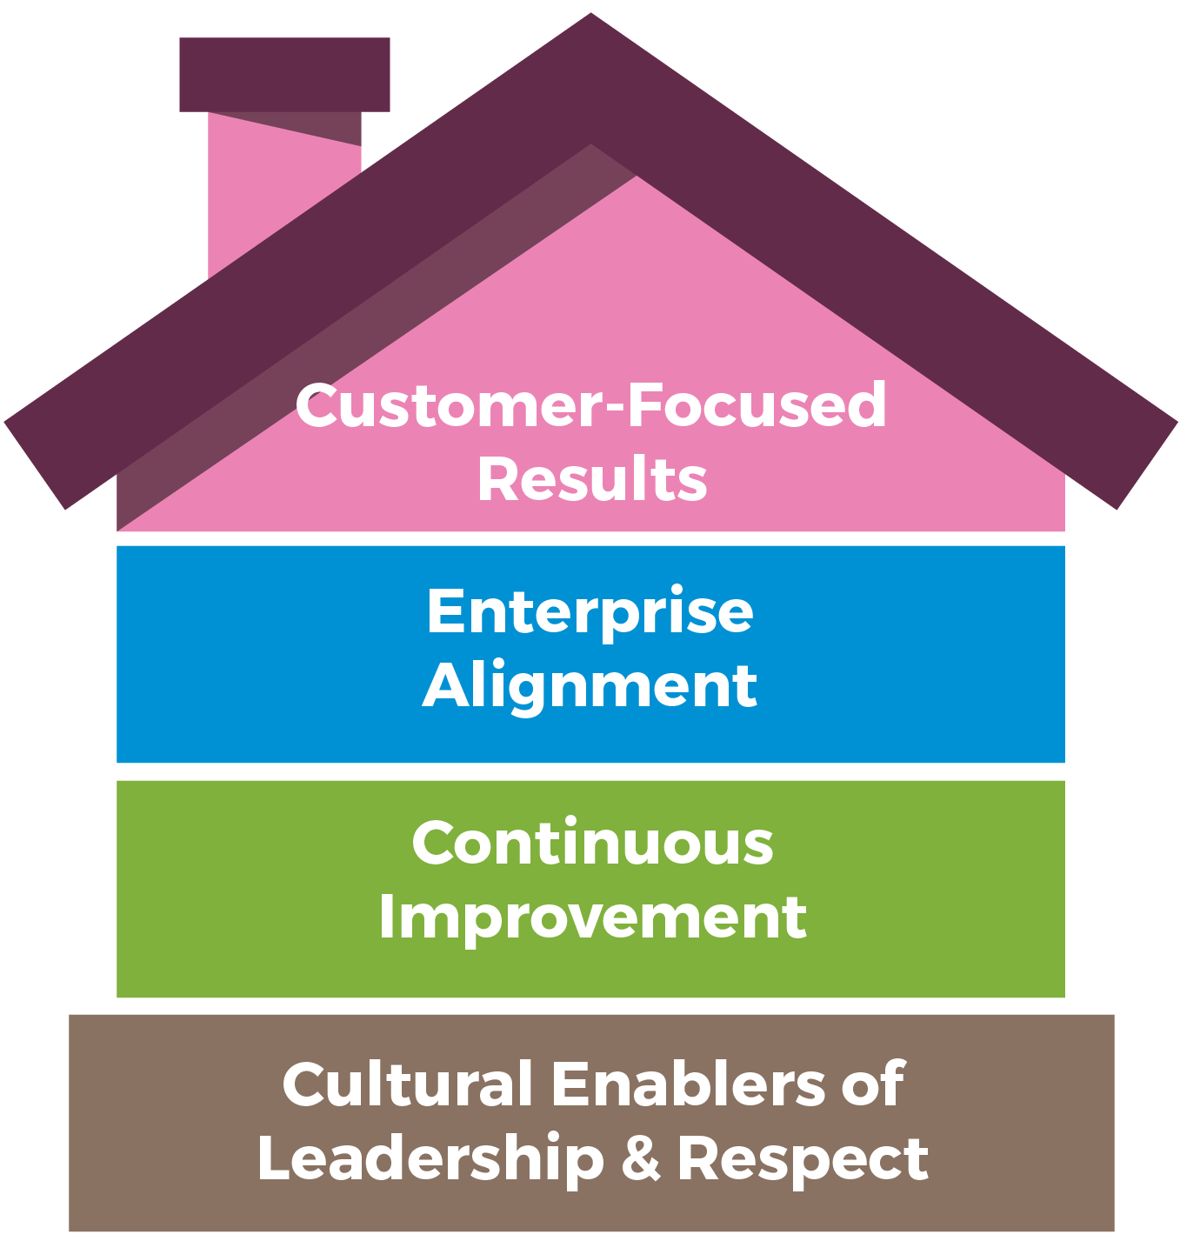
A Holistic Approach for Improvement
Real and Sustained
Lean Culture Come From Success in All
Four Dimensions
Notes:
Based on the Shingo Model –
Roof - RESULTS
Floor - PURPOSE
Floor - PROCESS
Foundation - PEOPLE

Slide 8
Each Floor Connects to Key Principles
Customers matter
to us.
We align around a common purpose.
We can always
do better.
Lead with humility and respect every individual
Notes:
Customer-focused results – Create value for the customer
Enterprise Alignment – create constancy of purpose
Continuous Improvement – Education on tools and methods to create improvement
Cultural Enablers – Lead with humility, respect every individual

Slide 9
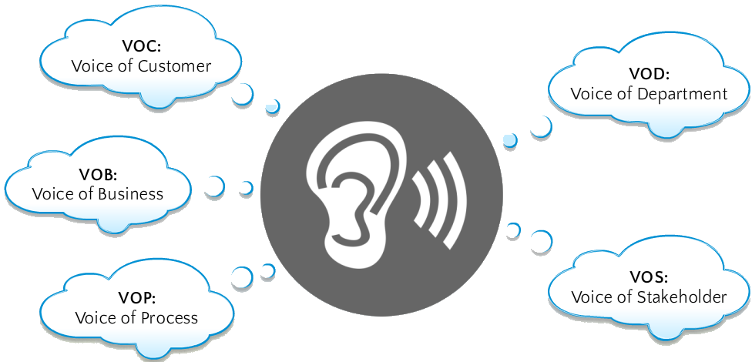
Customer Focused Results
Who is the Customer Advocate?

Slide 10

Questions to Ask: Customer-Focused Results
Who are our customers by process?
How can we better understand what our customers care about?
How will we measure what customers care about?
How and when will we assess our performance against what customers care about?
What customer-focused process
improvements will we address?

Slide 11
Each Floor Connects to Key Principles
Customers matter
to us.
We align around a common purpose.
We can always
do better.
Lead with humility and respect every individual
Notes:
Customer-focused results – Create value for the customer
Enterprise Alignment – create constancy of purpose
Continuous Improvement – Education on tools and methods to create improvement
Cultural Enablers – Lead with humility, respect every individual

Slide 12



Enterprise Alignment:
What is it like to drive in the fog?
Notes:
What & Why enterprise Alignment?
Most people can answer – what do we do? Or deliver as an organization?
But most can’t answer – where is your organization headed? How do I contribute and participate in that future state?
Picture yourself in your car driving along the highway on a clear day. Suddenly, you round a curve and you see this… What would you do?
(slow down, turn on your lights) Why?
Because you can’t see in front of you, you have low visibility, you’re not sure what coming up or how the road might turn. You proceed with caution and lose some momentum.
This is also how employees feel. Without clear vision, goals and plans, employees are operating in a fog, they can’t see what’s up ahead. They slow down. They are unsure about the road that lies ahead of them. Momentum is lost because they begin to question the path forward.
Unfortunately, some employees have been operating in the fog for a long time. They eventually become de-sensitized to operating in that kind of environment and dis-engage.
So let’s go back to you driving in your car, what do you do when the fog clears? You speed up. You can see the road ahead, you know what coming and you can plan how you will handle the road ahead.
And this what happens when leaders create a strategy and communicate it.
It lifts the fog for employees, less time and energy is wasted on uncertainty. Employees see the vision, they see themselves in it, and they keep trucking!
Transition: So, how do we lift the fog for our employees?
Transition: How do we make sure that employees don’t feel like they are following Alice in Wonderland? With Enterprise Alignment.

Slide 13
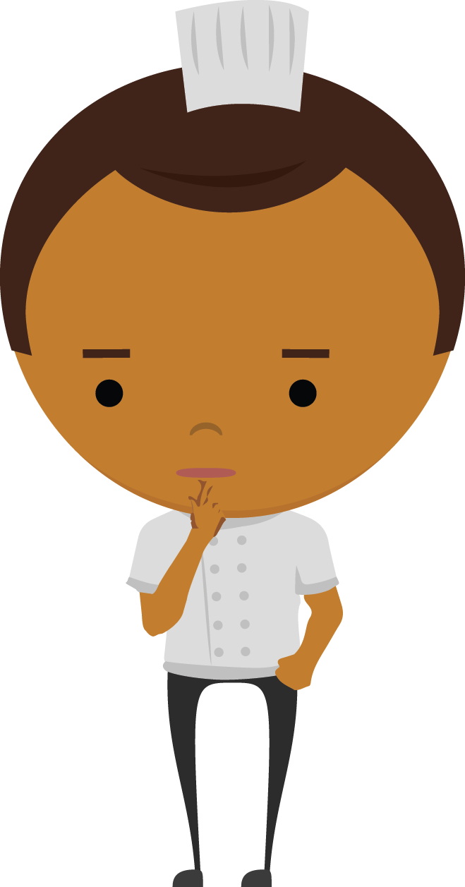
Questions to Ask: Enterprise Alignment
Who are we and what is our purpose?
Where are we headed and how will we get there?
How can we create alignment with the strategic plan and goals?
How can we use the roadmap to communicate alignment?
How will we communicate our
strategic plan to our staff?

Slide 14
Each Floor Connects to Key Principles
Customers matter
to us.
We align around a common purpose.
We can always
do better.
Lead with humility and respect every individual
Notes:
Customer-focused results – Create value for the customer
Enterprise Alignment – create constancy of purpose
Continuous Improvement – Education on tools and methods to create improvement
Cultural Enablers – Lead with humility, respect every individual

Slide 15
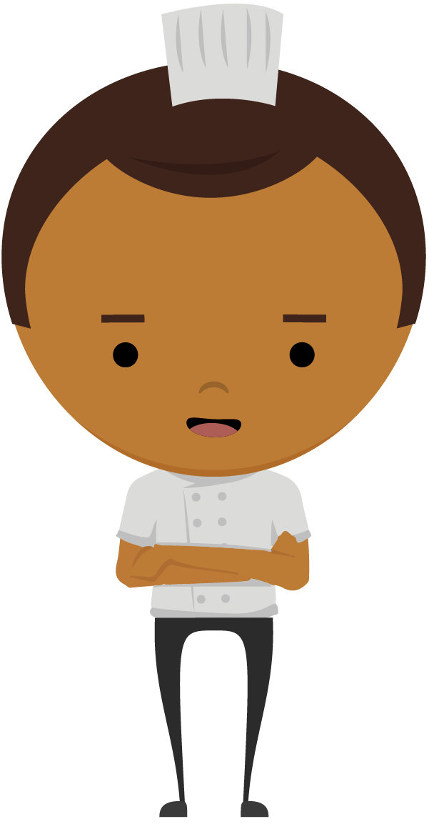
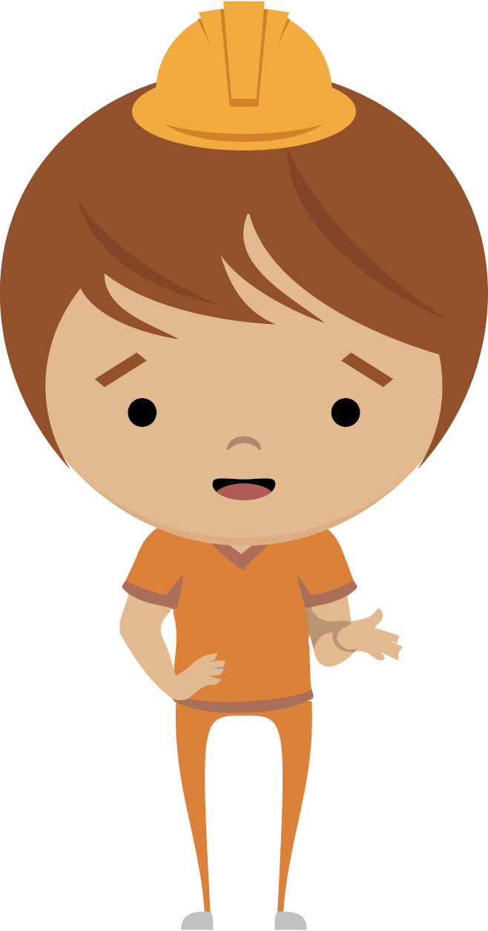
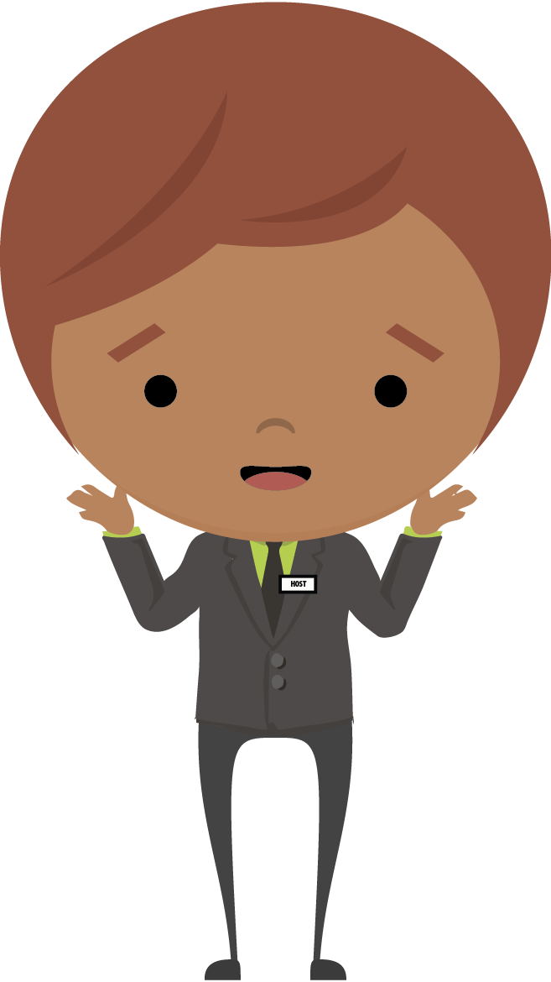

What Is Process Improvement?
Working on the process versus working in the process
Notes:
What and Why continuous improvement?
How much time is spent working on the process today? We tend to work IN the process
Allocate time for employees to spend working on the process

Slide 16
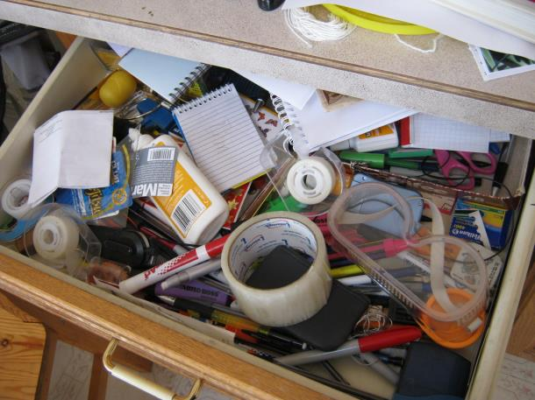
Processes Are Like Junk Drawers
Notes:
Processes are like junk drawers….If you don’t clean them out every once in a while,
it just gets filled with a bunch a stuff you just don’t need!
Processes need to be cleaned out every once in a while! When was the last time this process was cleaned out?
Ask: What are some of the benefits of continuous improvement?
Drive profitability by increasing revenue and reducing expenses
Better understand and deliver on customer requirements – external and internal
Improve the efficiency and effectiveness of internal processes
Empower employees at all levels to participate in improving the business
Gain a competitive advantage over competition
Drive data-based decision making instead of “jumping to solution”

Slide 17

Questions to Ask: Continuous Improvement
How will we continue to build our employee skills in problem-solving skills?
How will we give our employees time to work on process improvement?
How will we continue to develop our continuous improvement leaders?
How will we maintain focus on continuous improvement?
What systems will we implement to
promote employee problem-solving?

Slide 18
Each Floor Connects to Key Principles
Customers matter
to us.
We align around a common purpose.
We can always
do better.
Lead with humility and respect every individual
Notes:
Customer-focused results – Create value for the customer
Enterprise Alignment – create constancy of purpose
Continuous Improvement – Education on tools and methods to create improvement
Cultural Enablers – Lead with humility, respect every individual

Slide 19

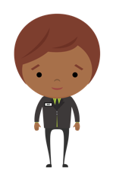


Leadership & Respect - Basic Premises
People prefer to do a good job
The process makes it difficult to do a good job
BASIC PREMISES
Employees did not create the process
Employees do not have the power to change the process on their own
The root cause of most problems is the way the work is designed
Notes:
What & Why we need to lead with humility and treat every individual with respect?
Most important category of all 4 – culture enablers - leaders need to understand the principles
People inherently prefer to do a good job.
What prevents them from performing to the best of their abilities is the process they work in.
The employees did not create the process. It was created by and is owned by leadership.
Employees don’t have the power to change the process on their own.
The root cause of most problems ultimately is the way the work is designed within the process

Slide 20
Be Hard on the Process, Not the People
Encourage awareness of problems and opportunities
Errors and problems are clues and opportunities to improve
Constant pressure to improve without a method is demoralizing
Processes often cannot handle all the different scenarios that exist
Every process is perfectly designed
to achieve exactly the results it gets
Notes:
Continuous Improvement: Be hard on the process, not the people
Processes often fall short of being able to handle all the different scenarios that exist. The result is typically some type of waste (defect, delay, etc.). It’s not the people doing things “wrong”, it’s the process that is not up to the demands and challenges
Repeated discussions about failed targets without a method to improve can demoralize even the most committed employee
Celebrate mistakes and errors that result from inadequate processes so that they can be corrected (don’t look for someone to blame for the problem)
Have our awareness tuned in sharply to identify problems that will inevitably arise and encourage the front line to expose these issues rather than try to cover them up.
In a blame culture, there is an effort to “hide it and cover yourself” or accept the status quo. Problems will continue and will invariably get worse.
Whole groups are sometimes left out
Certain roles are over-valued or under-valued – why do we do that
QUESTION: So what systems can be developed to help respect every individual? (Daily Management and Leader Standard Work)

Slide 21

1. Create Ideal Conditions
Reduce fear
Support a blame-free environment
Recognize behaviors that create a search for the guilty
Focus on the process, not the people
Recognize and promote desired behaviors
  Asking why
  Calculated risk-taking
  Making process problems visible
  Encourage experimentation
Notes:
Slide 12: Reduce Fear
Fear is the killer of experimentation, taking risks, and admitting the process problems exist. You could train front line workers until their blue in the face, but if the culture doesn’t promote CI, the momentum will die. Some places don’t have to deal with this.
Interesting Observation: Working with organization early stages of building CI culture. Created visual boards with metrics…A lot of the boards didn’t have any metrics that were coded red. Some of the boards had all green. What if something was red? How do people feel about it? How does leadership react to it? That can be an indicator of how much fear exists in an organization. And leaders should observe their own behavior and how they respond to a red dot on a visual board. The leader should ask: Am I behaving in a way that promotes CI?
Transition: We have to make it OK to fail, to experiment, to take calculated risks…

Slide 22
What Is Tolerated In Your Organization?
“
”
Culture is created by what
is tolerated and promoted.
- Dr. Henry Cloud -
Notes:
What is tolerated in your organization?
but he’s smart
SWA – We’ll miss you!
DEFENDING VALUES: LATER
Herb Keller got a call, from a customer,
Complaining
Write a letter
We’ll miss you
Southwest airlines does have an identity and values that they’ve defined as their own.
While going over their safety de-brief they say funny things throughout, like:
Ok people, if you are enjoying your drink, you need to stop enjoying it and start drinking it because we’re going to be collecting those cups before we land!
Well, one of these events caused a customer to complain. The customer was calling these charades unprofessional and offensive. And Herb Keller, the CEO at the time, wrote a note back to the customer. “We’ll miss you!”
We as leaders need to commit to the values and defend them. When we see people in the organization not following the values, we should do something.
If you see people disrespecting others, do something!
Transition: There’s a quote from a book, called “Boundaries for Leaders” by Dr. Henry Cloud. I highly recommend it. In that book is a quote…

Slide 23
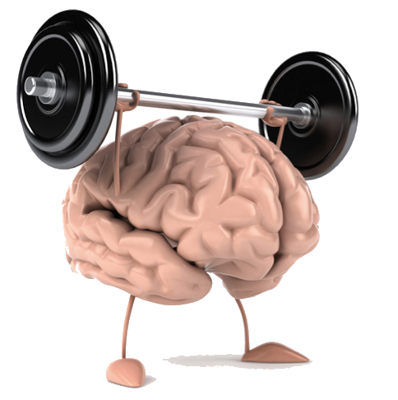
2. Build the Problem-Solving Muscle
Notes:
One of the primary mindsets of a Lean culture: Build the Problem-Solving Muscle
Problem: organizations have too many problems and not enough problem-solvers
ASK: How do you go about doing that?
Humans possess an astounding capability to learn, create and solve problems. Toyota’s ability to improve and adapt lies in the actions and reactions of the people in the organization.
Their ability to effectively understand situations and develop smart solutions. Toyota considers the improvement capability of all their people the “strength” of the company.
You may have employees who haven’t flexed their muscle in a long time! They’re out of practice. You may ask them to start using their muscle and they may not know what you mean!
What leader characteristics or behaviors are ideal for being a coach?

Slide 24

Question for You
If the mindset should be to build the
problem-solving muscle:
What do leaders need to do
more of (or less of)?
Notes:
Transition:

Slide 25
3. Be Strategic With All Four Floors
Customers Matter To Us
Customers matter
to us.
We Align Around A Common Purpose
We align around a common purpose.
We Can Always
Do Better
We can always
do better.
We Treat All People With Respect
We treat everyone with respect.
Notes:
Refer to the White Paper – the Lean Culture Survey.
Hand out the survey...have them take it, and collect them.
Discuss the survey...

Slide 26
Stop – Start – Continue
  What do you want to STOP doing
  to help create a stronger Continuous Improvement culture?
  What do you want to START doing
  to help create a stronger Continuous Improvement culture?
What do you want to CONTINUE doing
to create a
stronger Continuous Improvement culture?
Notes:
Slide 16: Stop-Start-Continue
Basic change management tool
Stop: letting people bully each other or blame each other, or disrespect each other.
Start: Start enforcing respect for each other; Have discussions with people that treat others disrespectfully;
Continue: celebrating graduates from belt level training
Aren’t comfortable with that – Crucial Conversations Training for leaders
Transition: Question for you…

Slide 27
Possible Roadmap Actions
Customer Focused Results | Enterprise Alignment | Continuous Improvement | Cultural Enablers
Map Value Streams and Core Processes Identify customers by process Identify customer metrics by process Identify opportunities for improvement from the Voice of Customer Gather feedback from customers on processes | Build Vision, Mission, Values with Continuous Improvement Develop Scorecards Identify 6-18 Month Initiatives Build a 12-18 month roadmap around executing the four components of Continuous Improvement culture Build and execute a communication plan | Establish infrastructure and roles for supporting Continuous Improvement Design and Deliver Continuous Improvement Training Select and Execute Projects Celebrate Success with Continuous Process Improvement | Plan Leadership and Employee Engagement Conduct Training for Leadership Development Employee Engagement Survey Track Progress on Continuous Improvement and Make adjustments as needed

Slide 28
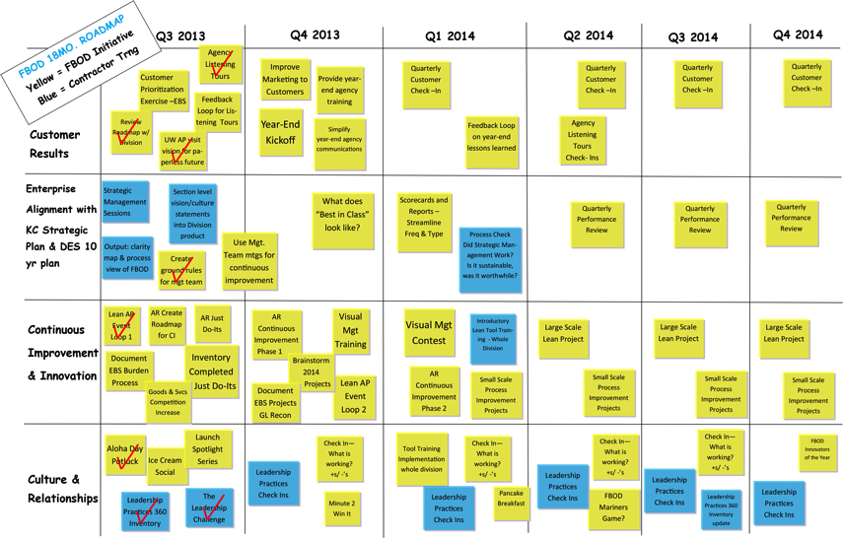
A Roadmap for the Four Components

Slide 29

Call to Action
Share knowledge about the 4 components
Assess your own culture
Discuss which components need attention
Create a roadmap encompassing a high-level plan to improve each component

Slide 30
3. Be Strategic With All Four Floors
Customers Matter To Us
Customers matter
to us.
We Align Around A Common Purpose
We align around a common purpose.
We Can Always
Do Better
We can always
do better.
We Treat All People With Respect
We treat everyone with respect.
Notes:
Refer to the White Paper – the Lean Culture Survey.
Hand out the survey...have them take it, and collect them.
Discuss the survey...

Slide 31
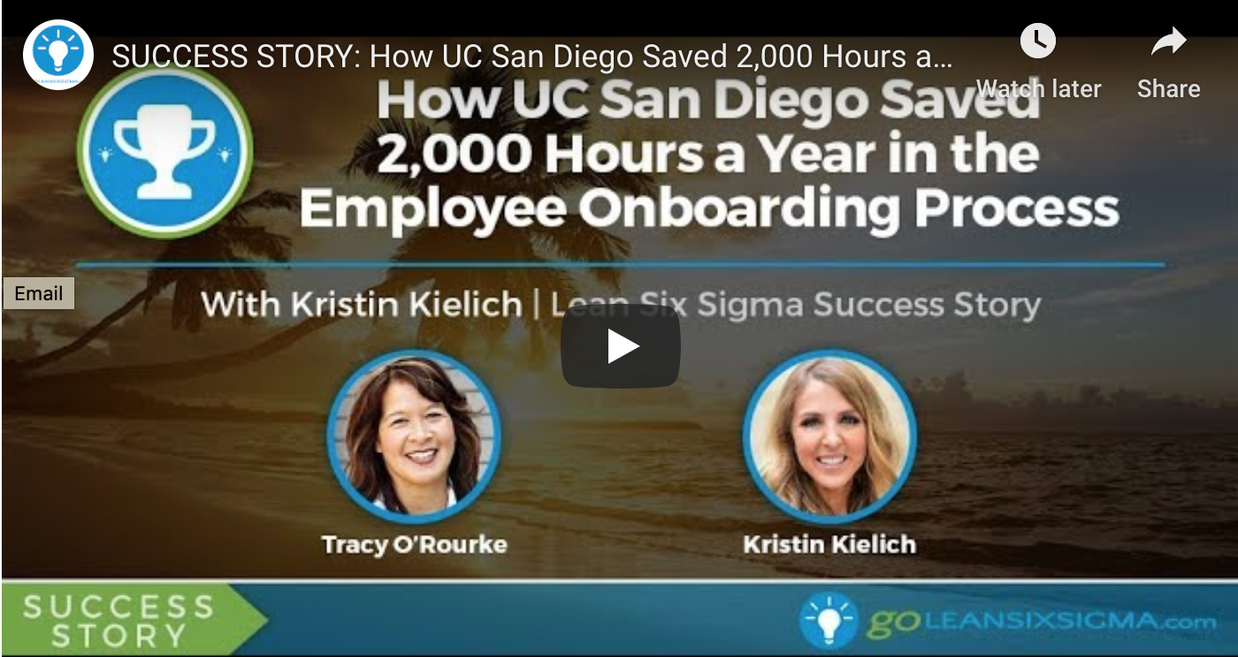
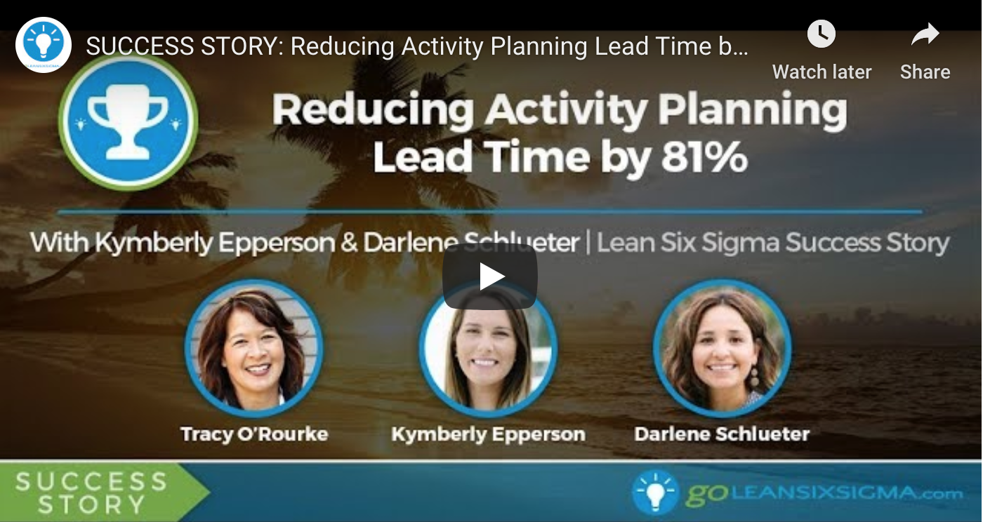
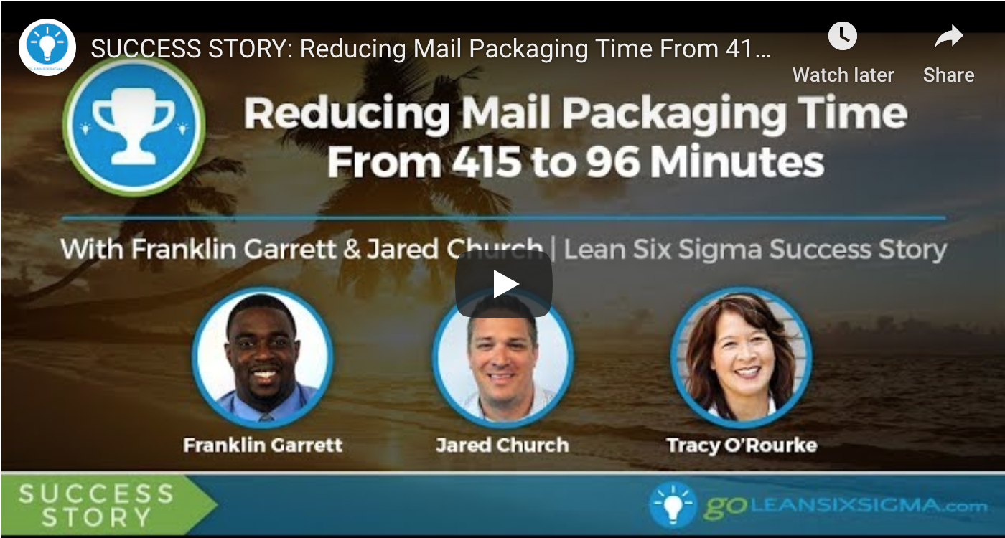
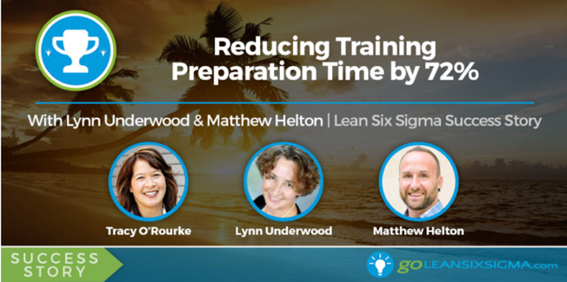
Examples of UCSD Project Presentations
Go to GoLeanSixSigma.com website. Go to “Free Resources”
Tab. Go To “Webinars”. Go To “Success Stories”
OR: Go to website and search by presenter name with the search function

